Slide 1

Client Portal Walkthrough
Date: 6/12/26

Slide 2
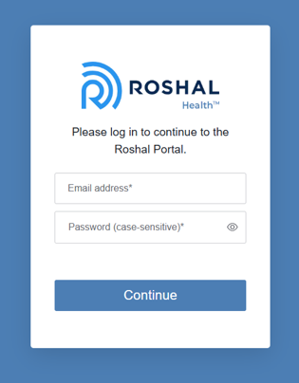
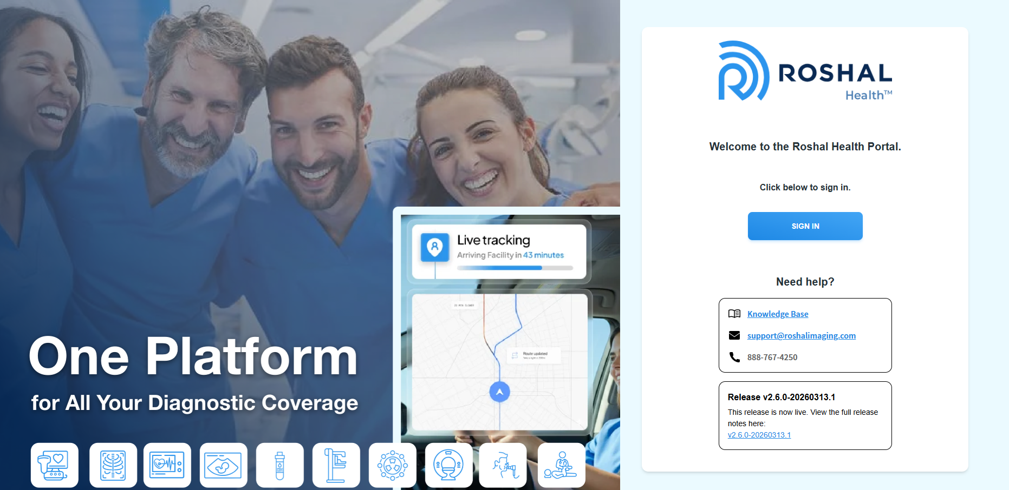
Sign In
1. Sign In
  Visit the Client Portal website and click Sign In
    https://portal.roshalimaging.com
  Enter your email address and password (provided by Roshal)
1
2
2
1

Slide 3
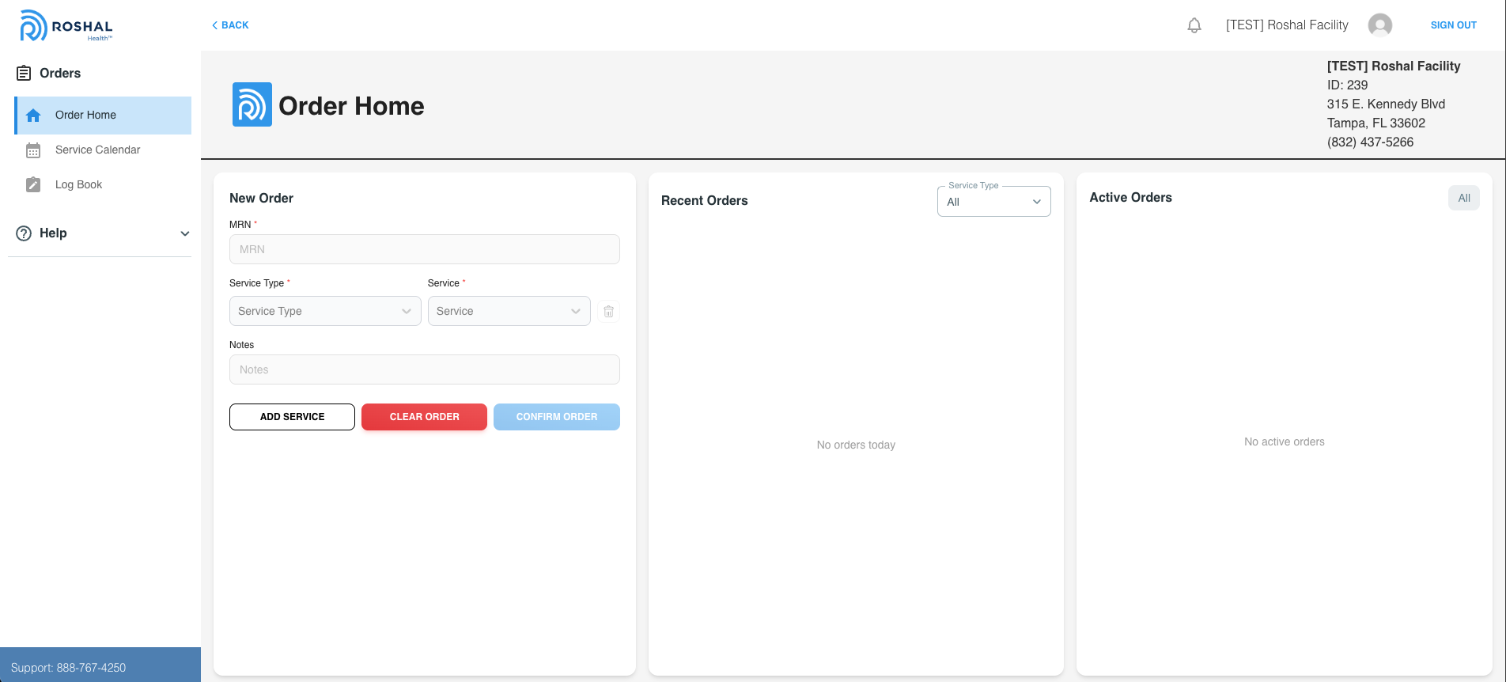
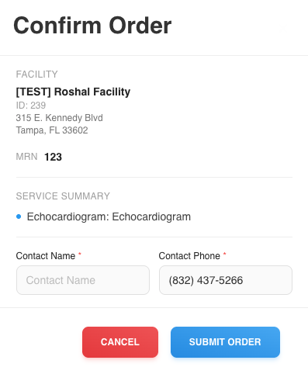
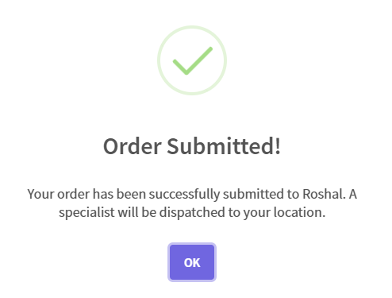
Order Home
2. Order Home
  To place an order for a specific service, navigate to the Order Home tab on your left side menu
  Enter in the necessary information
    MRN
    Service Type (Ultrasound, ECHO, etc)
    Service (Service related to service type)
    Any additional Notes
  Click Add Service to add additional services to your order
  Click Clear Order to erase the information you entered
  Click Confirm Order to place it
    Confirm order details and add in a Contact Name
    Click Submit Order
      Once the order is successfully placed a popup will confirm this
1
1
2
2
3
3
4
5
4
5
6
7
8
8
6
7

Slide 4
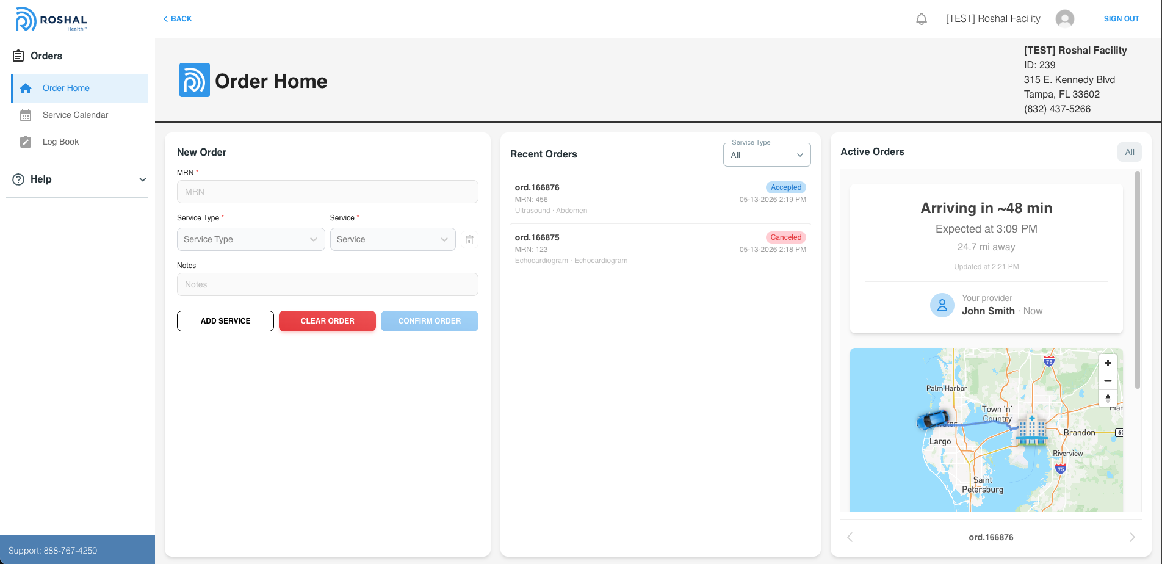
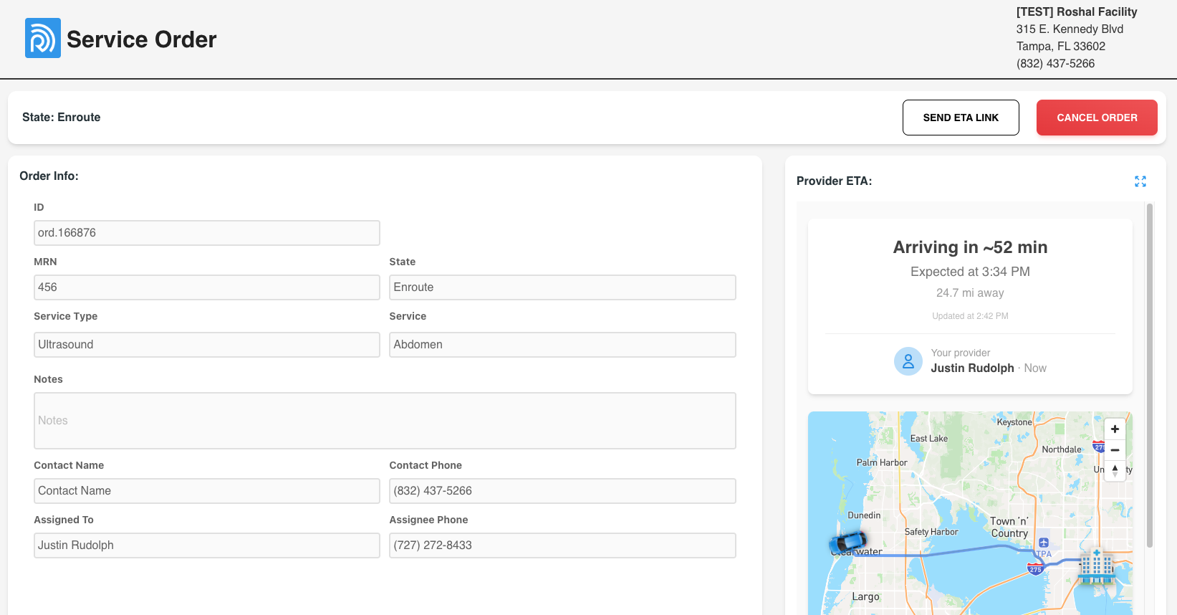
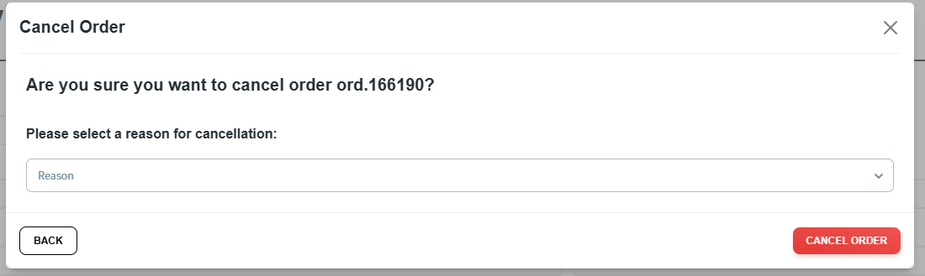
Recent Orders & Active Orders
3. Recent Orders & Active Orders
  Recent Orders show orders placed within the last 24 hours, orders still in progress, or any scheduled/upcoming orders
    View the Status of the order
    Users have the option to Filter orders by Service Type
  Active Orders show currently active orders along with the providers ETA in relation to the order placed
    Switch between orders by using the arrows at the bottom of the view
  Click inside of a Recent Order to view more details
    Send ETA Link allows you to enter any phone number and send the ETA tracking link to that person
    Cancel the order here if needed
      Provide a Reason
1
1
4
2
3
3
6
2
4
5
6
6
7
8
7
5
5
8
9
9

Slide 5
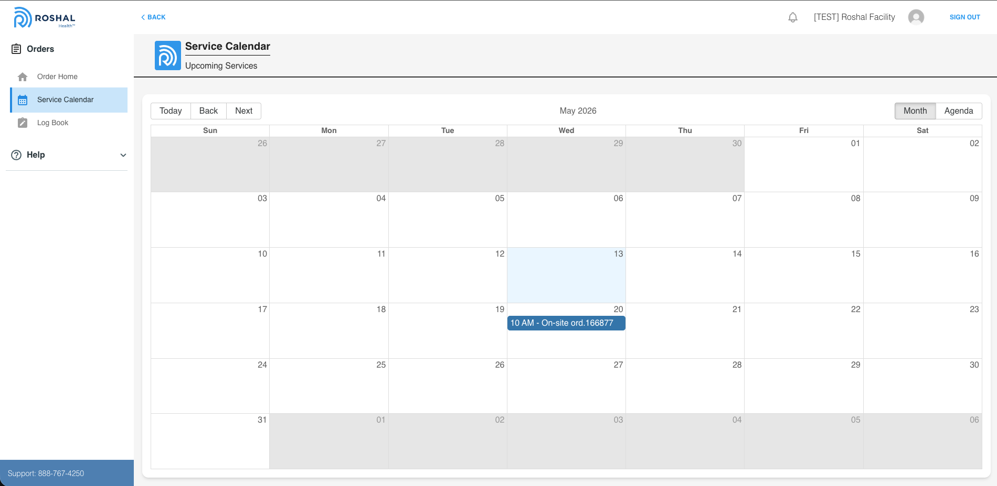
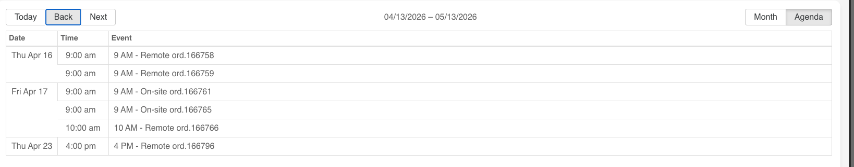
Service Calendar
4. Service Calendar
  To view all your upcoming/scheduled orders, navigate to the Service Calendar, tab on your left side menu
  Click Today to navigate you back to the current day
  Click Back or Next to switch months
  Click Month to view the monthly calendar layout
    Click inside an order to to view more order details
  Click Agenda to view the agenda layout
1
1
2
3
4
6
2
3
4
5
6
5
6

Slide 6
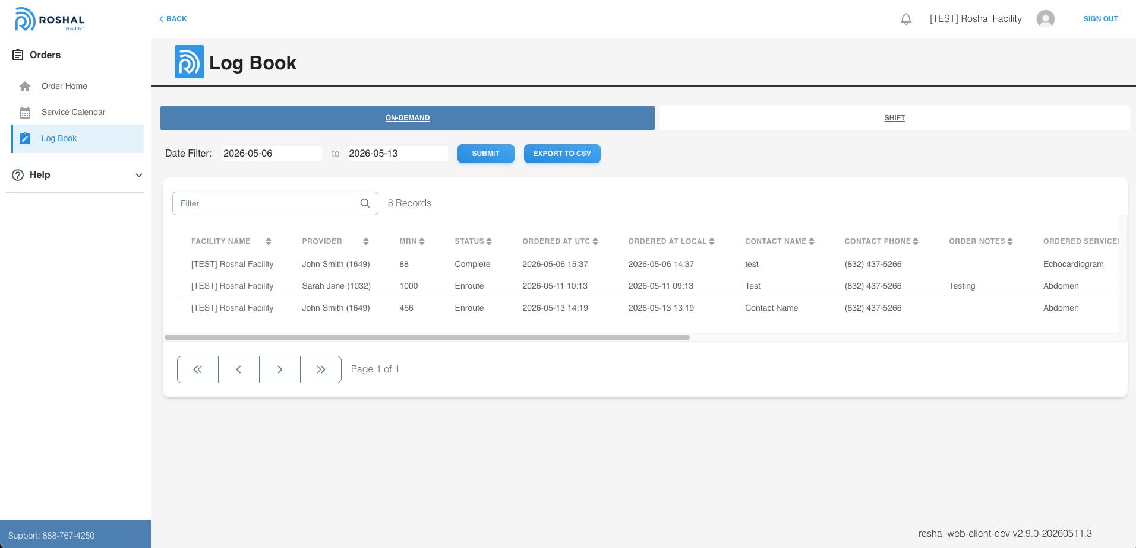
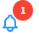
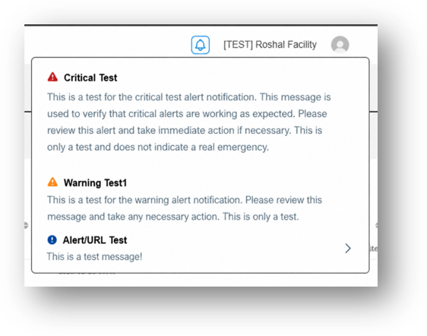
Log Book
5. Log Book
  To view all your past placed orders and their pertaining information, navigate to the Log Book, tab on your left side menu
    View order information - Provider, MRN, Order Date, etc
  Select the Date Filter to view past orders in a certain date range, then click submit
  Export your past orders to a CSV File
  Filter Search to find specific orders
5. Notifications
  To view system notifications and alerts click on the bell icon in the top right corner
  From here you can view your system notifications
    Critical Alerts
    Warnings
    Informational
      If a notification has an arrow on the right, it can be clicked on and will navigate you to the URL attached
1
6
2
1
3
4
3
5
4
2
5
6
7
7
8
8

Slide 7
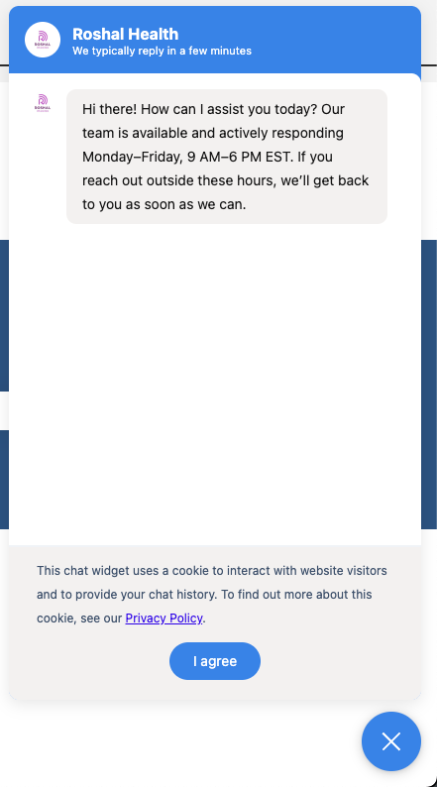
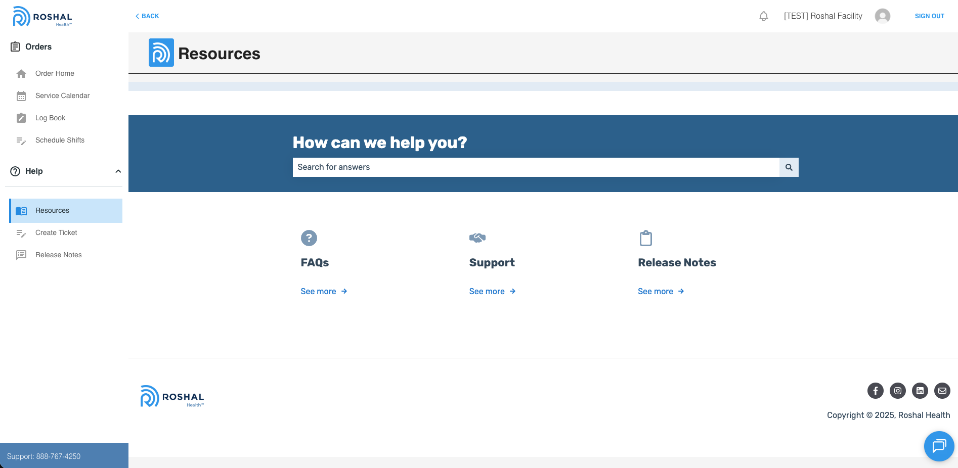
Resources
6. Resources
  Select the Resources option on the left menu
  Select FAQ option for frequently asked questions relating to the Client Portal utilization
  Select Support option to assist with troubleshooting any issues that are being experienced
  Select Release Notes option to review all enhancement and updates to the Client Portal
  Select the Text bubble located at the bottom right side of the client portal screen to chat live with our Support Team.
    If not visible, please refresh
  Hours of Live chat are Monday-Friday, 9am-6pm EST
  Agree to the terms of the chat by selecting the “I agree” blue circle
  Select the Blue X to close and exit the live chat room
1
2
3
4
1
5
2
3
4
6
5
6

Slide 8
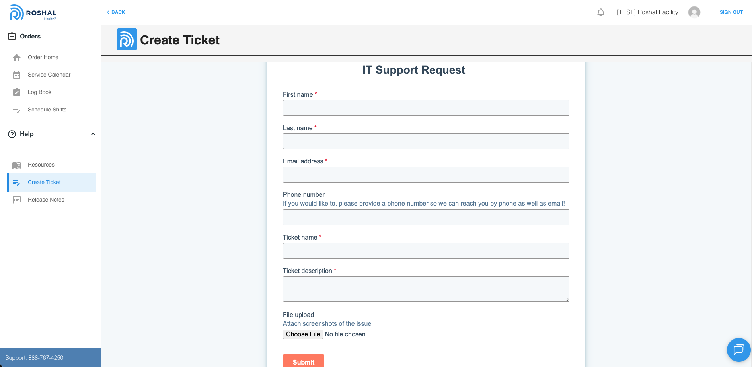
Create Ticket
7. Create Ticket
  Select Create Ticket to open a Support Ticket with the Roshal Support Team
  Fill in First/Last Name, your email address and phone number where you may be reached.
  Name the ticket for your reference
  Provide a brief description of the issue/reason the ticket is being created
  Upload any file to provide more information relating to the ticket – Only if applicable.
  Select the Submit option to send your ticket to the Support team.
  An email confirmation will be sent to the email address provided as well as updates to the ticket.
1
2
2
3
1
4
3
4

Slide 9
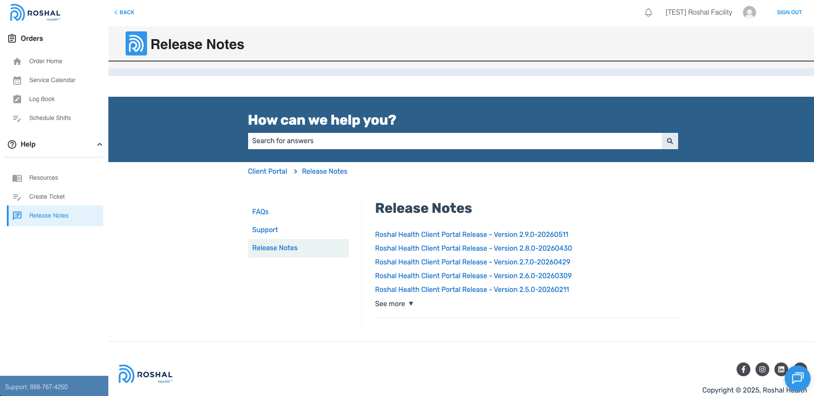
Release Notes
8. Release Notes
  Select Release Notes option to review all enhancement and updates to the Client Portal
1
1

